Slide 1
4 ways to access UNIX system from your desktop

Slide 2
1. If your UNIX system is VMWare guest…
You can use:
VMWare workstation (newer than 8.x)
VMWare vSphere client
These are similar to VNC(because these are also using VNC protocol).

Slide 3
1. Using VMWare desktop client
VMWare HOST
Guest OS
Guest OS
Guest OS
Guest OS
Connect & interact
Your Windows desktop
Or, you can simply start up VM on your machine
Your Windows desktop
VMWare workstation / vSphere client
VMWare workstation
Guest OS
Simply run the guest OS

Slide 4
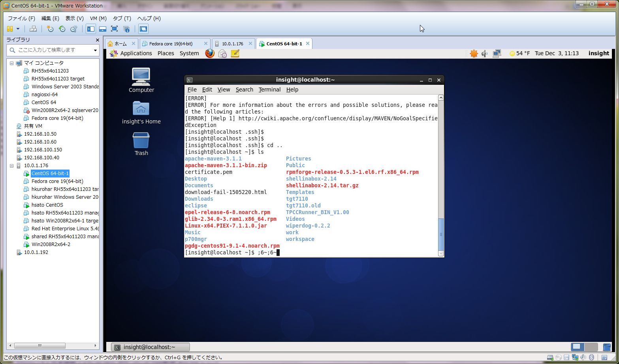
1. Using VMWare desktop client

Slide 5
2. Use Terminal Emulator
Software
Putty
TeraTerm(ttssh)
I recommend this.
Good:
Very light weight.
You can use your favorite input method(and keyboard settings), and easy copy&paste(only text).
Bad:
If the network condition is bad, your work will be killed unpredictably.
No GUI.

Slide 6
2. Using Terminal Emulator.
Regardless if you are using VMWare or not, you can use this…
UNIX OS
User process
The process in the Unix OS is directly
Connected to Terminal emulator, so if
Network connection is corrupted, both of
Terminal emulator and user processes on
The UNIX os are killed…
Your Windows desktop
Terminal Emulator

Slide 7
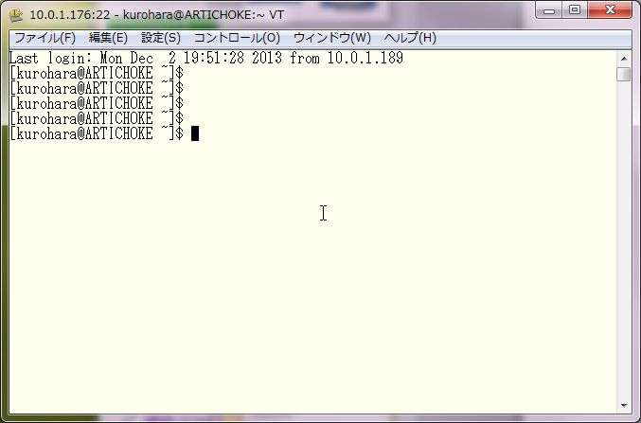
2. Using Terminal Emulator.

Slide 8
3. Use VNC
Software
Ultra VNC
Etc…
Good:
Light weight
Full GUI.
Even if network connection is disconnected, your work still remain in the server side.
Bad:
You cannot use your favorite input method(or keyboard settings).
You have to set up VNC Server.
Sometimes, some graphics will be distorted.

Slide 9
3. Using VNC.
Regardless if you are using VMWare or not, you can use this…
UNIX OS
User process
Virtual Graphics/Keyboard device
Your Windows desktop
VNC client software
VNC client software connect to the software
Representing “Virtual Console” device.
So it is safe even if network connections has lost;
the User process will continue to run, and You
can re-connect then continue your work again.

Slide 10
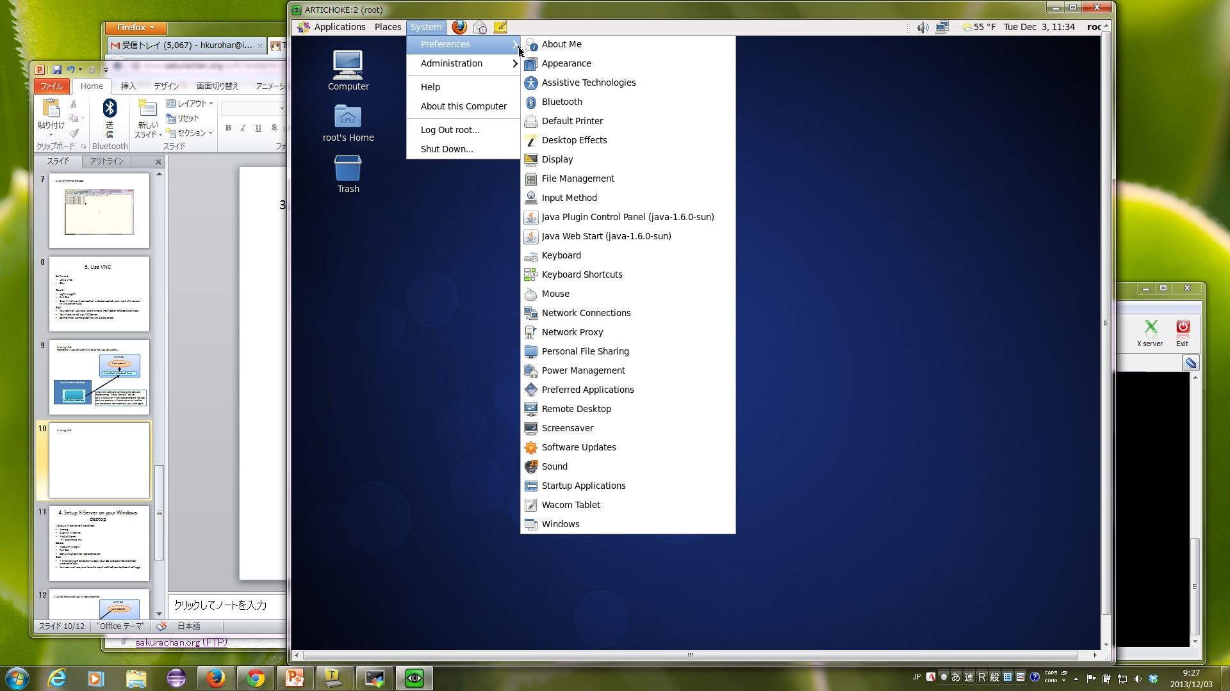
3. Using VNC.

Slide 11
4. Setup X-Server on your Windows destop
Various X-Server software(free)
Xming
Cygwin X-Server
MobaXterm
I recommend this.
Good:
Medium weight.
Full GUI
Genuine graphics representation.
Bad:
If the network condition is bad, your GUI process may be killed unpredictably.
You can not use your favorite input method(nor keyboard settings).

Slide 12
4. Using X-Server on your Windows machine.
UNIX OS
User process
Your Windows desktop
The User process which can connect to X server is
Called “X-client” which is built as “X-Client” using
X-library software.
So , not all software can be used with X-Server.
And , if network connection has lost, User process
That have been running will be killed.
X server software

Slide 13
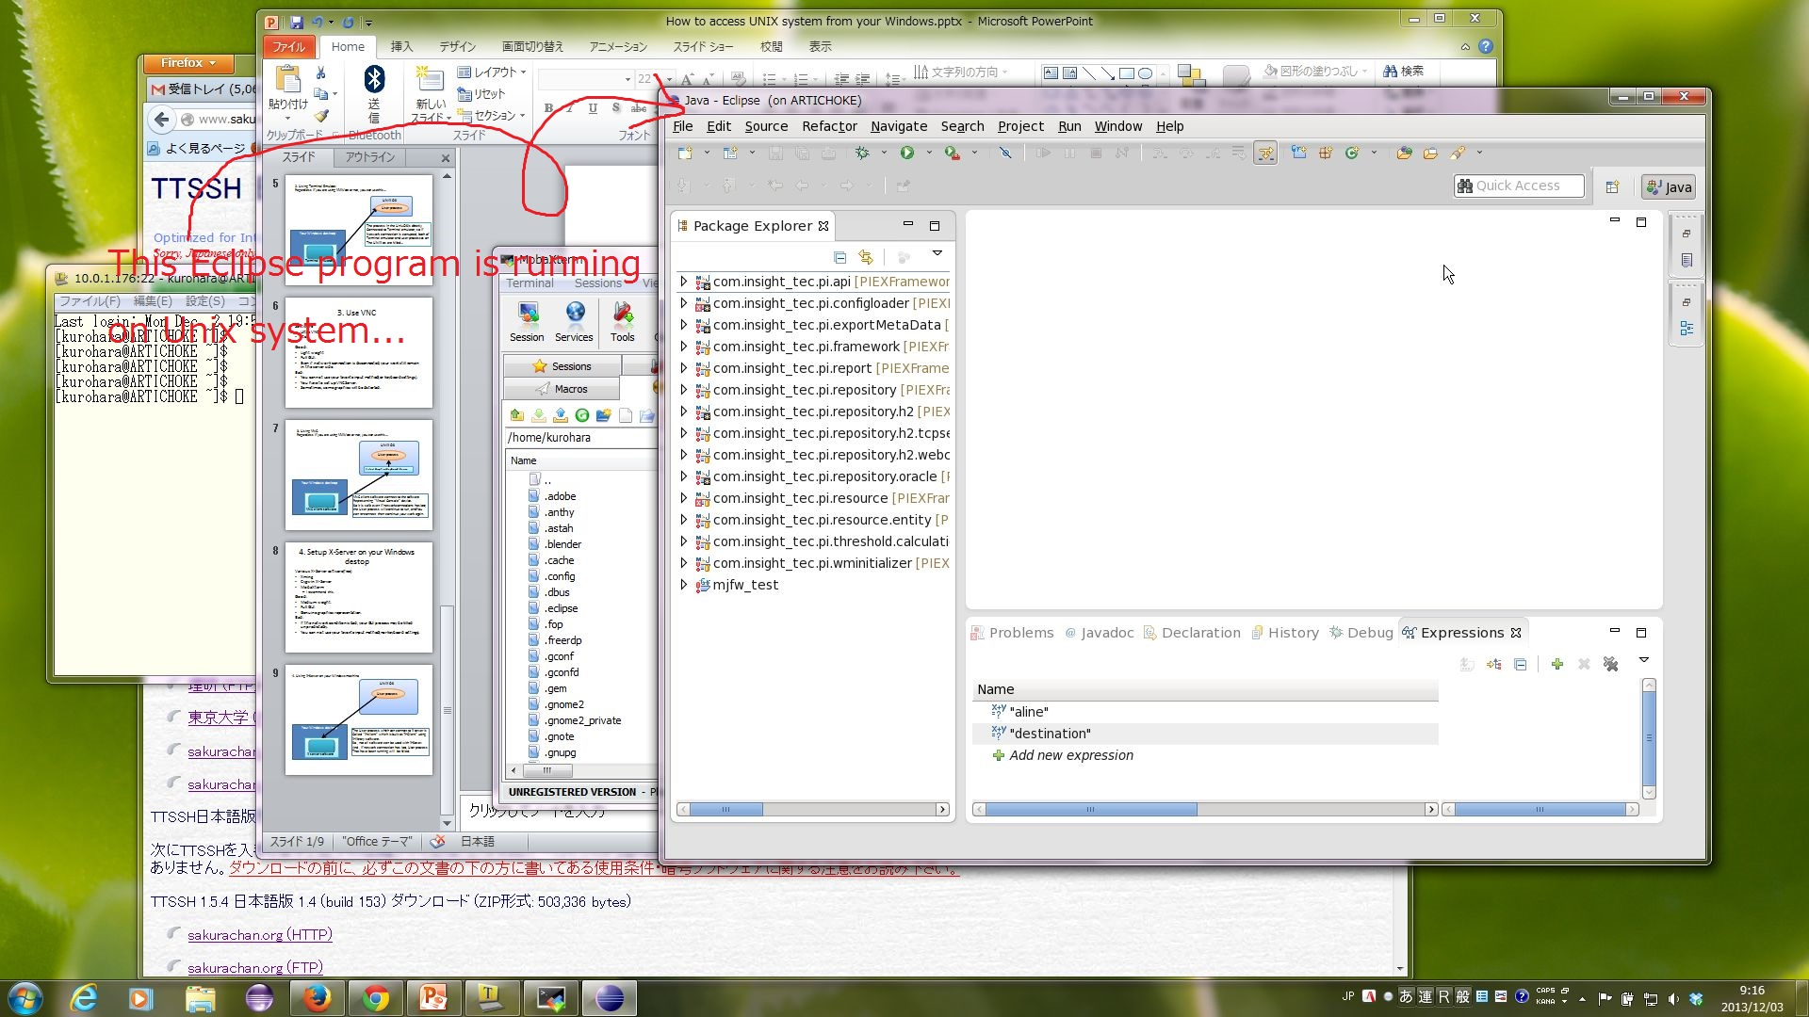
4. Using X-Server on your Windows machine.

Slide 14
End of memo

